Slide 1
Introduction to (Advanced) Multimedia Information Processing and Communications – (A)MIPaC
Mikołaj Leszczuk, Jakub Nawała
Notes:
Bez uwzględnienia correction quiz:
3.0: 0,408163265306122
3.5: 0,489795918367347
4.0: 0,571428571428571
4.5: 0,653061224489796
5.0: 0,73469387755102
Z uwzględnieniem correction quiz:
3.0: 0,408163265306122*0,710144927536232=0,289855072463768
3.5: 0,489795918367347*0,710144927536232=0,347826086956522
4.0: 0,571428571428571*0,710144927536232=0,405797101449275
4.5: 0,653061224489796*0,710144927536232=0,463768115942029
5.0: 0,73469387755102*0,710144927536232=0,521739130434782

Slide 2
Module Summary

Slide 3
Module Summary
The course consists of:
  Computer exercises on multimedia (mainly image and video) data processing and transmission
  Micro-project (MIPaC only)
Classes will be held at computers

Slide 4
Teaching Resources
University e-Learning Platform

Slide 5
Contents of Teaching Resources
Communication platform, e.g., for announcements
Attendance
Classes:
  Intro talks
  Slides
  Exercises
  Supplemental exercises
  Quizzes

Slide 6
Forms of Classes

Slide 7
Forms of Classes (1/2)
Computer classes, each consisting of introductory talk, exercise, report submission (+ suppl. ex.)
Consultations:
  On-duty: during class hours (immediate response, full availability)
  Off-duty: 24/7 😉 (delayed responses possible, limited availability)
Notes:
Reports should be simple. Hints what to include in the report are given in the text of instructions to practical exercises.

Slide 8
Forms of Classes (2/2)
Supplemental exercises:
  MIPaC: 3×
  AMIPaC: 4×
Quizzes (2×), scheduled individually:
  MIPaC: 1× (final)
  AMIPaC: 2× (midterm, final)

Slide 9
Method of Calculating the Final Grade

Slide 10
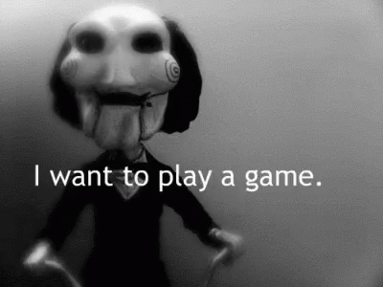

Slide 11
Development from Pixel to Video
(MIPaC/AMIPaC)
Class/talk attendance (mark it!) →
1 Knowledge point
Report submission →
4 Practice points
Supplemental exercises →
? Skill points
Quiz →
40 Test points
Notes:
40/80 -> MIPaC/AMIPaC points
Notice the total number of points exceed the amount required to have 5.0.

Slide 12
The Sigmas
(MIPaC/AMIPaC)
Σ collected (Knowledge, Practice, Test) points → grade
According to the regulations of the AGH studies
Skill points count extra! %
Σ test(s) minimum 40%
Notes:
40/80 -> MIPaC/AMIPaC points
Notice that the total number of points exceeds the amount required to have 5.0.

Slide 13
Software

Slide 14
Software
Python + Jupyter
MATLAB + Simulink
VLC media player
Software specific to a given exercise

Slide 15
Visit AGH Moodle (UPEL) to Track Your Progress

Slide 16
Thank You for Your Attention!

